Slide 1
Overall Structure of the GeneAgent Code
main_cascade.py
call
worker.py
call
call
call
call
call
call
get_enrichment_for_gene_set.py
get_pathway_for_gene_set.py
get_complex_for_complex_id.py
get_disease_for_disease_id.py
get_domain_for_domain_id.py
……
All of these are in the **apis** directory

Slide 2
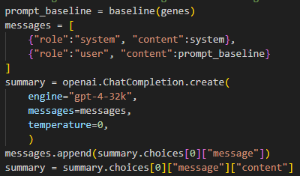
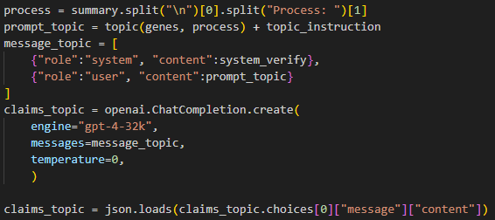
Process of main_cascade.py
Gene Set
Generation by
Standard GPT-4
Claims for verifying Process Name

Slide 3
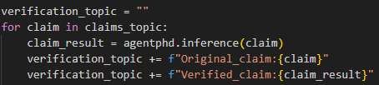
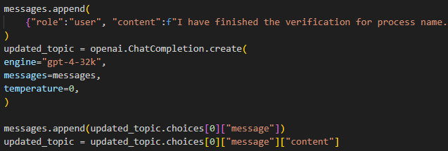
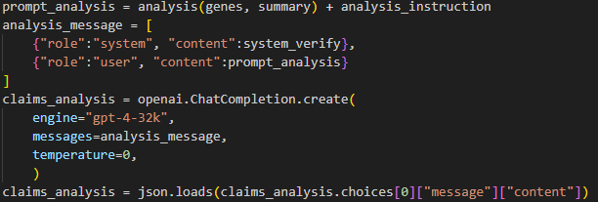
self-Verification for Process Name
Call worker.py
Modification based on Verification Report
Claims for verifying Analytical Texts

Slide 4
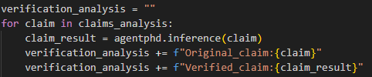
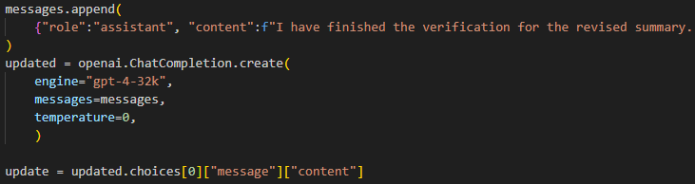
self-Verification for Analytical Texts
Call worker.py
Summarization base on Verification Report
Output

